Slide 1

CAR RENTAL SYSTEM
Submitted in the partial fulfillment for the award of the degree of
BACHELOR OF ENGINEERING
IN
COMPUTER SCIENCE WITH BIG DATA ANALYTICS
PRESENTED BY :
ASHRITH RAVIKANTI (20BCS4378)
VIVEK BAITARU (20BCS4403)
APEKSHA GUPTA(20BCS4390) Under the Supervision of:
MS. MONIKA

Slide 2
OUTLINE
Introduction
Objective
Tools Required
Methodology
Results and output
Problem Formulation
Conclusion
Future scope
References

Slide 3
INTRODUCTION
The concept aims for automobile rental businesses to hire out their vehicles to clients. This program aids in the addition and management of automobile data as well as the admin's understanding of the consumers. This initiative aids users in the rental of automobiles.
Vehicle transactions, such as vehicle details and driver information, are stored in the car rental system.

Slide 4
On each transaction, the system aims to manage its vehicle usage. This will simplify the process of recording vehicle booking transactions, listing and sorting their booking transaction reports, providing accurate information such as car availability on a daily basis, and easing the burden of paperwork.

Slide 5
OBJECTIVE
This project is intended to assist a vehicle rental firm in allowing automobile rentals to be made using an internet system. It allows users to browse for available vehicles, see profiles, and book automobiles for a certain amount of time.
It offers an easy-to-use interface that allows users to search for vehicles and hire them for the time period they want. They might also pay through the internet.
The rental automobiles will be divided into categories such as economy, premium, and so on. The user will be able to make reservations based on the sort of automobile that the client requires.

Slide 6
TOOLS REQUIRED
HARDWARE SPECIFICATIONS:
Processor Intel dual core
RAM 8GB
Monitor 15 inch color
HDD Minimum 20 GB
Key board Standard 102 keys
Mouse 3 buttons
SOFTWARE SPECIFICATIONS:
Operating system Windows 10
Code Editor Visual Studio Code
Environment MINGW
Language C++

Slide 7
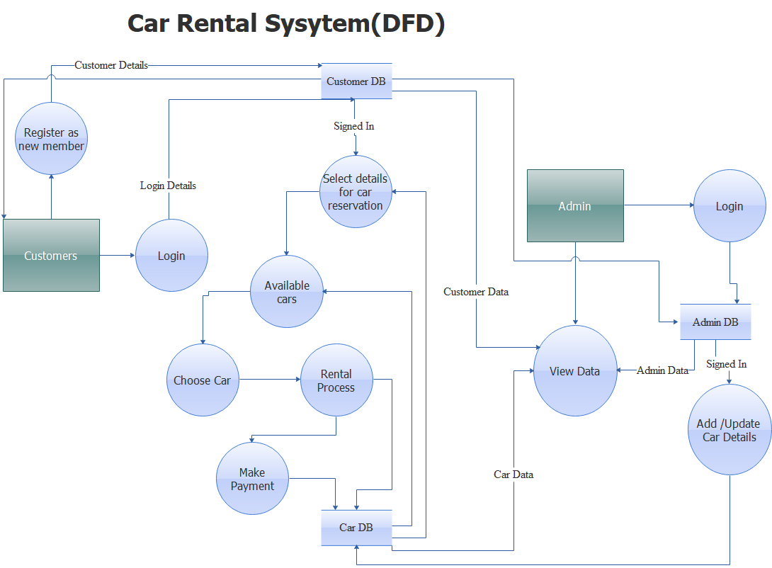
METHODOLOGY USED

Slide 8
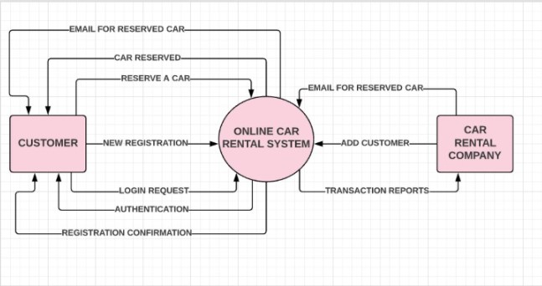
Data flow diagram of level 0

Slide 9
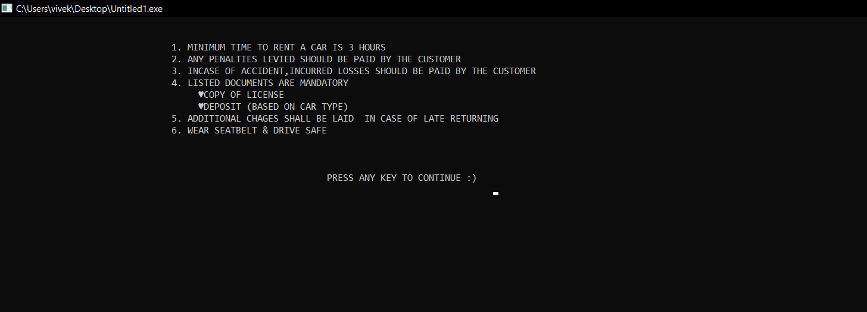
RESULTS
Terms and conditions

Slide 10
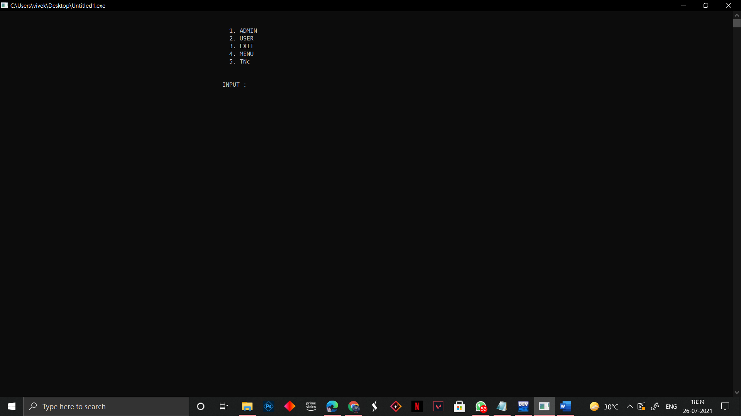
Main Menu

Slide 11
ADMIN INTERPHASE
The administrator logs into the admin interface using his password and can
1. Add An Admin
2.Remove An Admin
3.Access To Data
4.Add A Car
5.Delete A Car
6.Can Reset The Car List

Slide 12
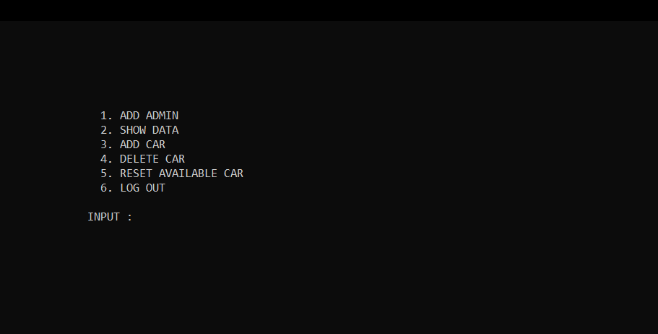
IN ADMIN

Slide 13
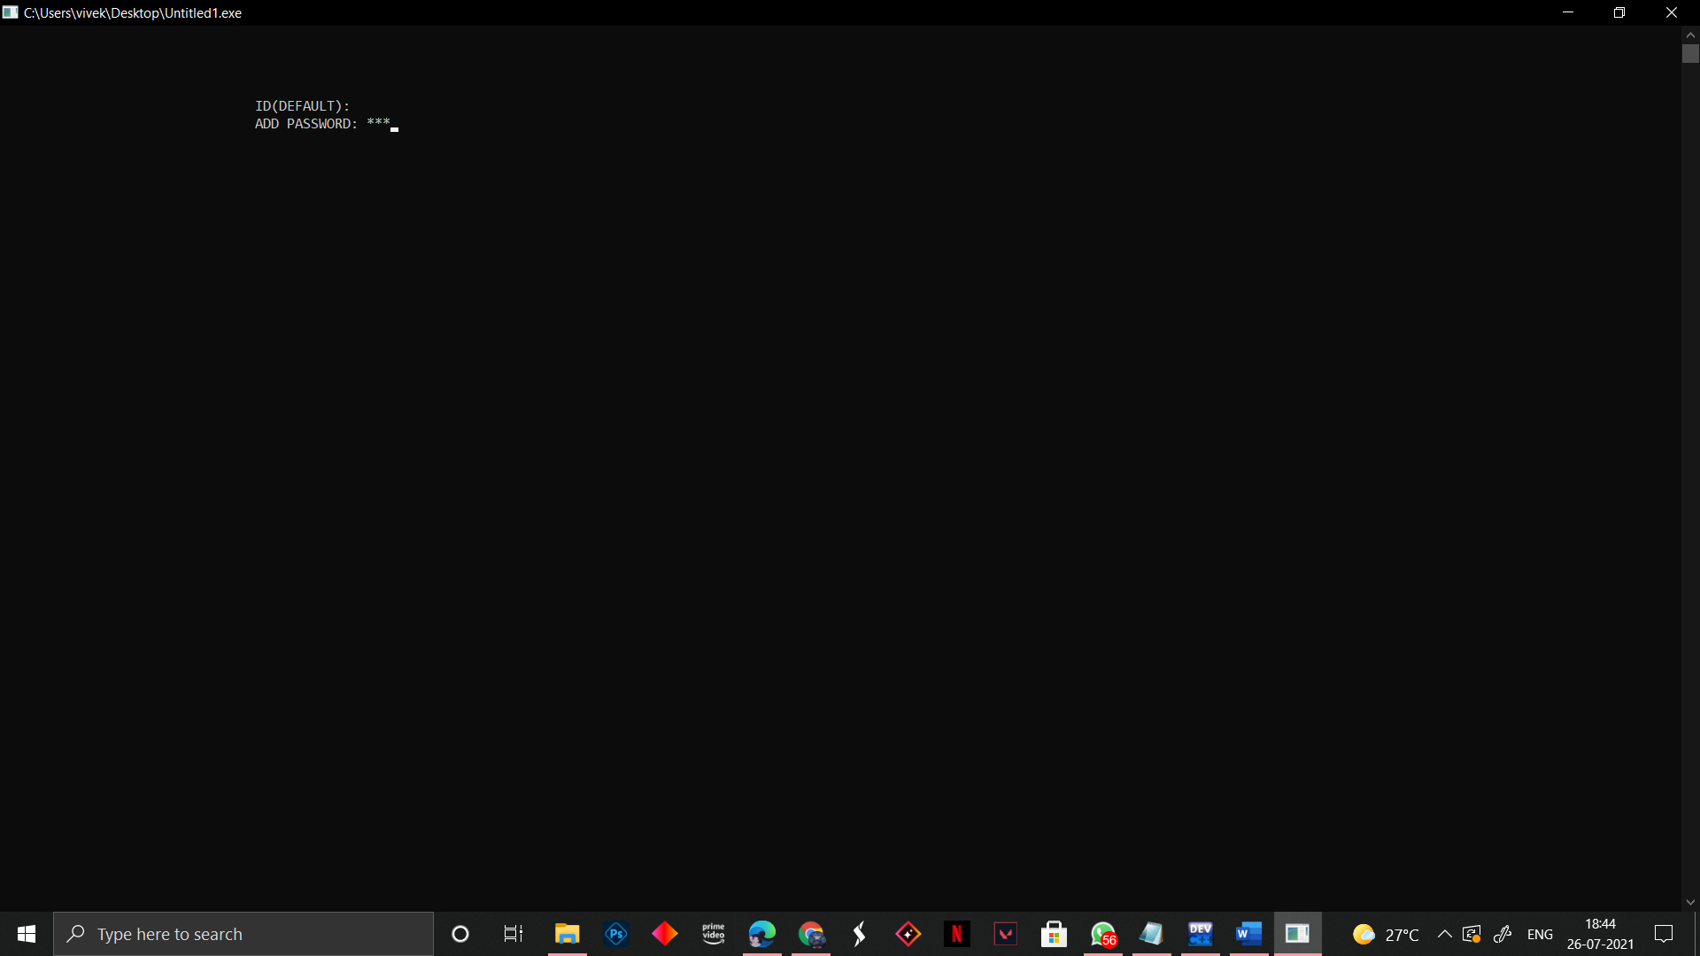
ADD ADMIN & REMOVE ADMIN
An Administrator can add another administrator and also can remove the existing administrator,By using the add & remove admin options.

Slide 14
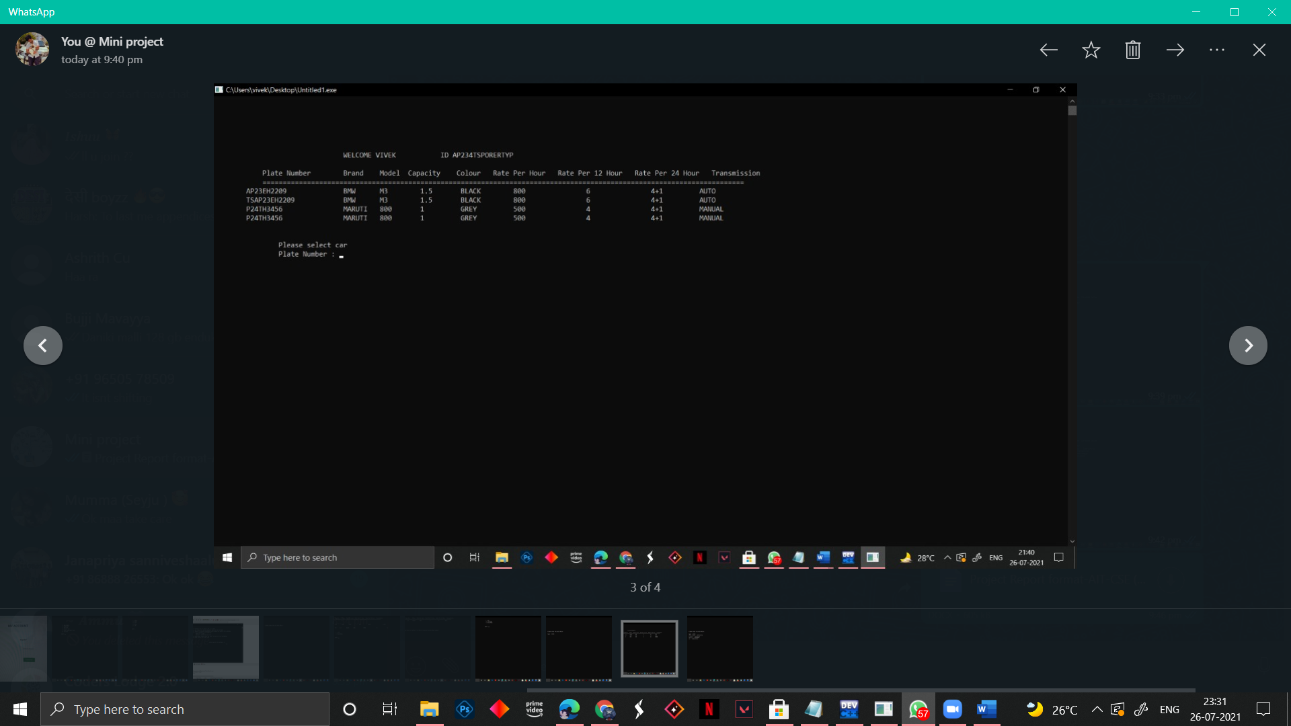
SHOW DATA
The admin can access the car data as well as user data by selecting show data option.

Slide 15
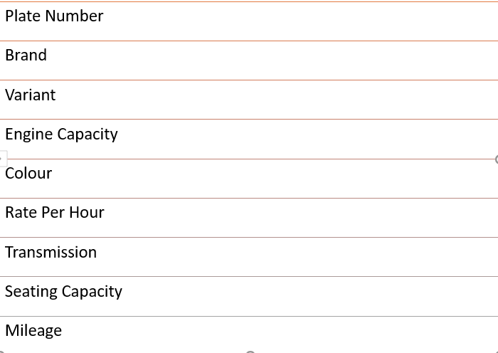
ADD CAR
Admin can add a new car by adding the following information

Slide 16
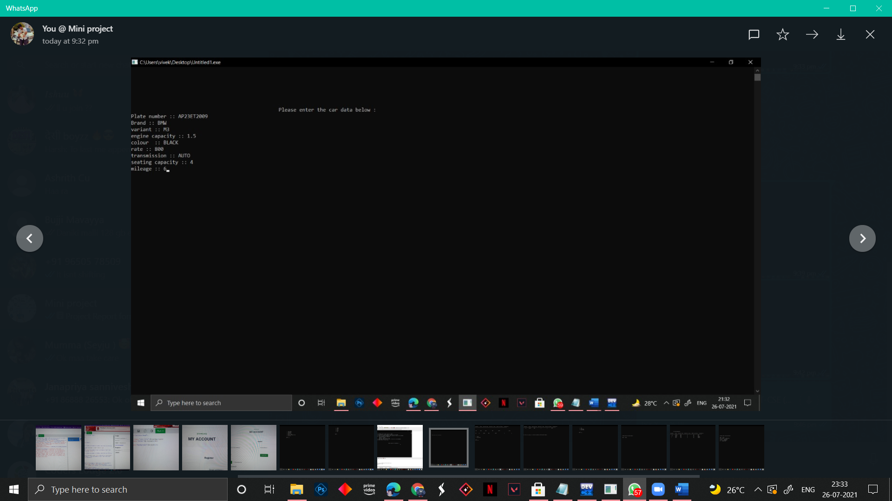

Slide 17
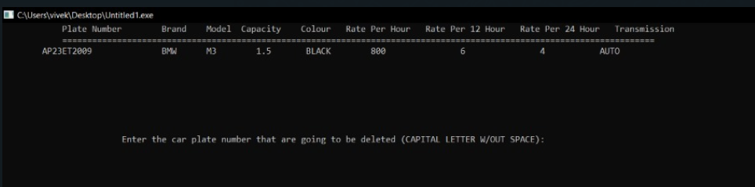
DELETE CAR
Admin can delete a car by entering the plate number of the respective car.

Slide 18
RESET AVAILABLE CARS
Admin Can Erase The Car Data Completely By just choosing that option.

Slide 19
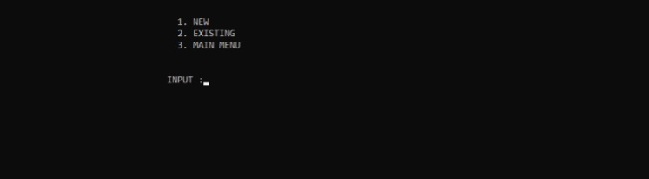
USER INTERPHASE
A Person Can Login Through User Interphase To Rent A Car .

Slide 20
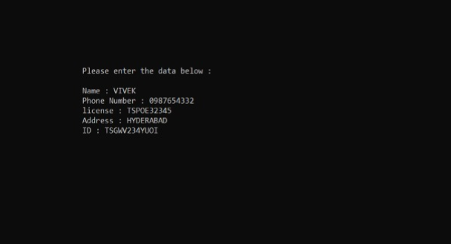
NEW USER
The following information should be entered by the new user before renting a car. An existing user can log in using his login credentials and book a car.

Slide 21
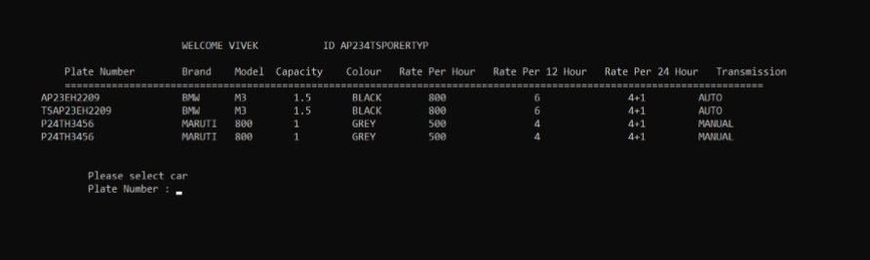
RENTING A CAR
The user must first choose a car by entering its licence plate number, then the total number of hours he desires to hire, and lastly the necessary payment will be presented on the screen. As a consequence, the user should pay for the rental automobile and make a payment.

Slide 22
PROBLEM FORMULATION
This project includes a wide variety of topics, from business ideas to computers, and it necessitated the completion of several research in order to achieve the project's objectives. The following topics are covered:
Vehicle rental sector: This involves research on how the car rental industry operates, the processes involved, and the opportunities for improvement.
The C++ programming language was used to build the program e.

Slide 23
CONCLUSION
When compared to previous experiences, when every activity related to vehicle rental business was restricted to a physical place only, the car rental industry has emerged with new goods.
Customers may now book vehicles online, rent automobiles online, and have the car delivered to their doorstep if they are a registered member, or they can travel to the office to pick up the car.
The web-based vehicle rental system has benefited both clients and the car rental company by allowing them to operate their business more efficiently and effectively.

Slide 24
FUTURE SCOPE
We can make this c++ programme an android application in the future, as well as update many other features, such as adding photos to the application utilising cutting-edge technology.
We can even ask the customer to provide the id proof. i.e,(Aadhar or any government ID)

Slide 25
REFERENCES
https://www.geeksforgeeks.org/file-handling-c-classes/
https://www.google.com/url?sa=t&source=web&rct=j&url=http://www.cplusplus.com/forum/general/3766&ved=2ahUKEwiTnLeXyebxAhWWzzgGHXvnAI4QFnoECAMQAQ&usg=AOvVaw2je3mzj0WclDAS_qR3lWXR
https://stackoverflow.com/questions/15914839/unable-to-read-a-text-file-in-c
https://www.geeksforgeeks.org/converting-strings-numbers-cc/
https://www.cplusplus.com/reference/ctime/
https://www.geeksforgeeks.org/stringstream-c-applications/

Slide 26
.
THANK YOU

